Slide 1
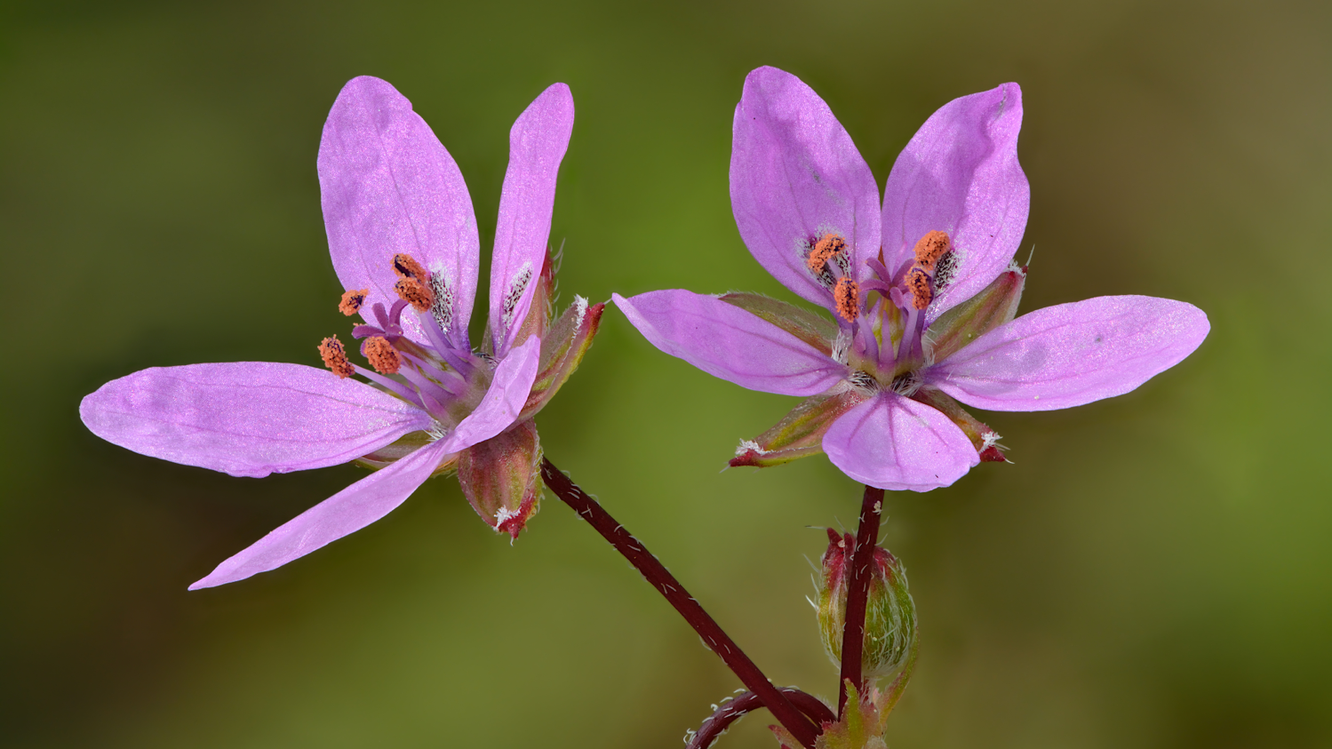
Plant Taxonomy Flower Morphology

Slide 2
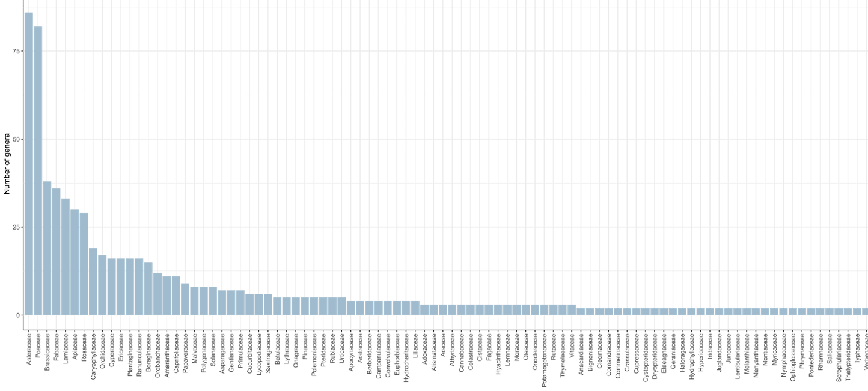
Plant families in Wisconsin
149 families
805 genera

Slide 3
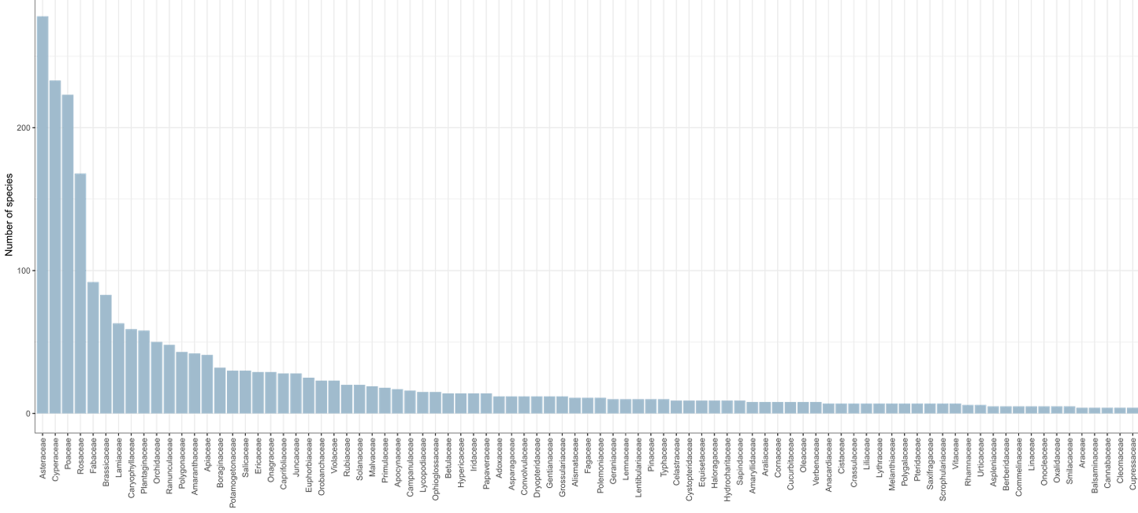
Plant families in Wisconsin
About 2,500 species
1,731 species are native

Slide 4
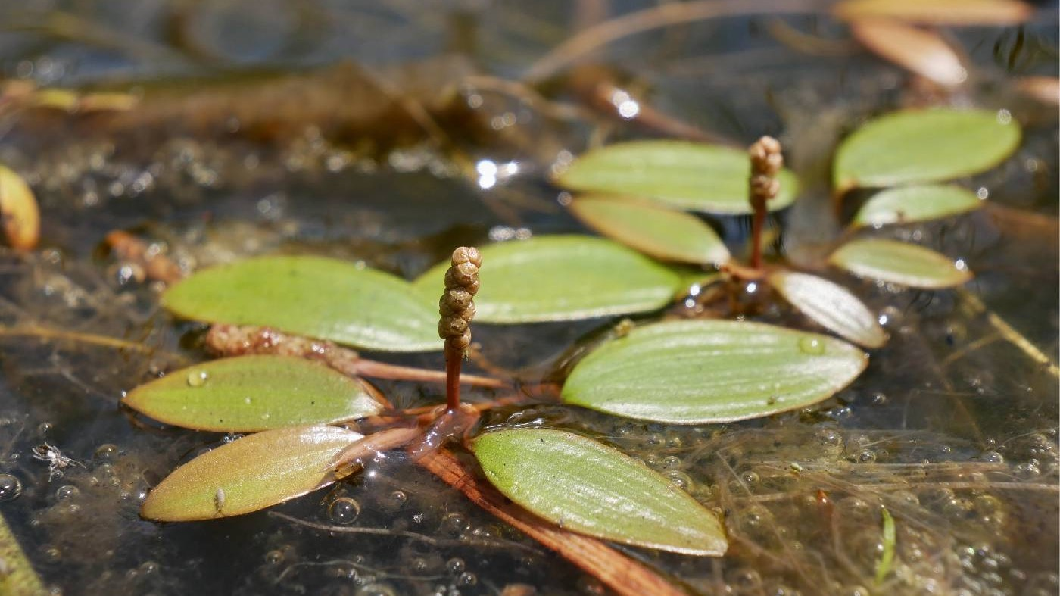
Aquatic Plant Biology (BIOLOGY 359)
Fall semesters

Slide 5
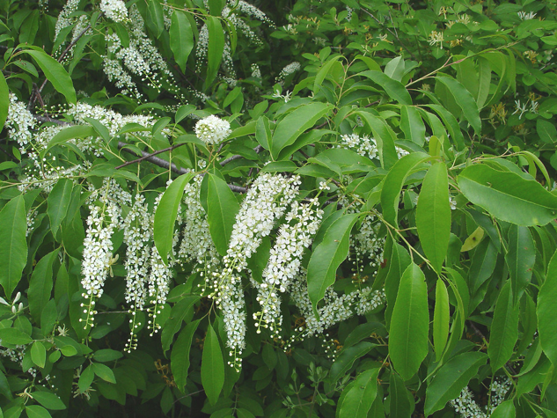
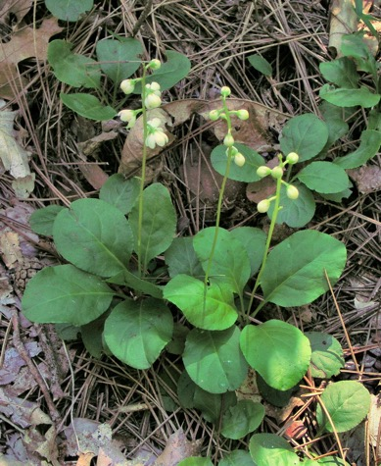
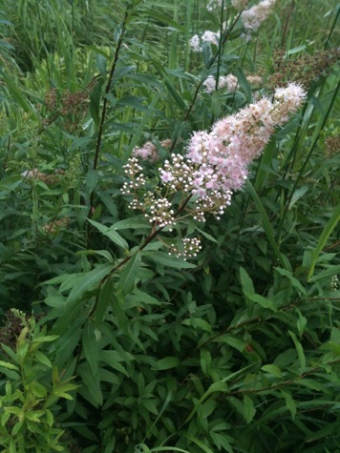
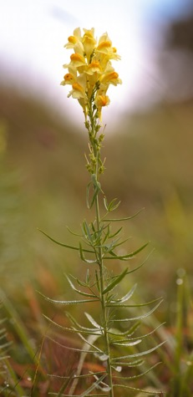
General plant form
Terminology reference: http://tinyurl.com/7bwy3uw
Vegetative
Reproductive
Prunus
Pyrola
Spiraea
Linaria (butter-and-eggs)

Slide 6
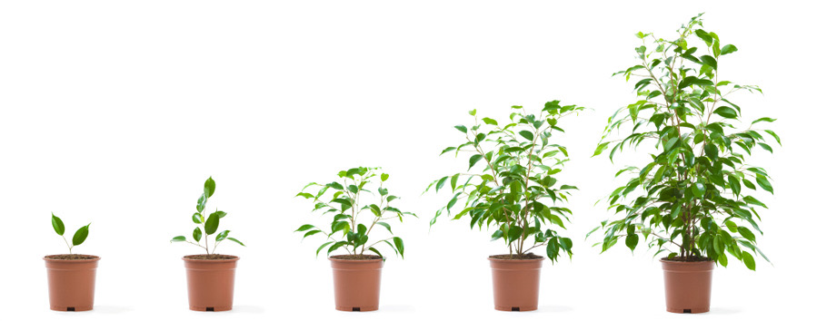
How plants grow
Plant growth is indeterminate and modular
Indeterminate?
Modular?

Slide 7

The importance of flowers
Function?
Often conspicuous

Slide 8
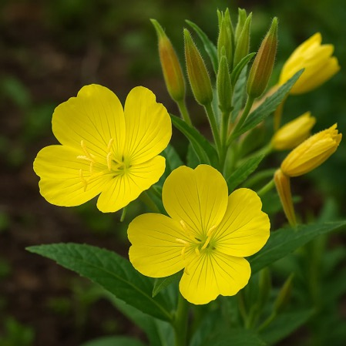
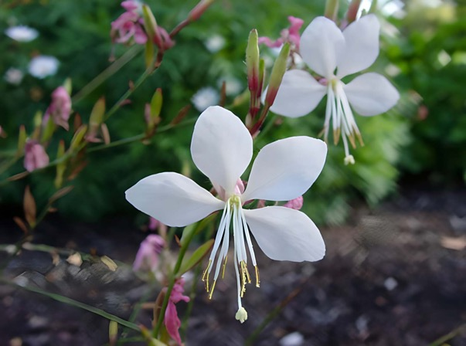
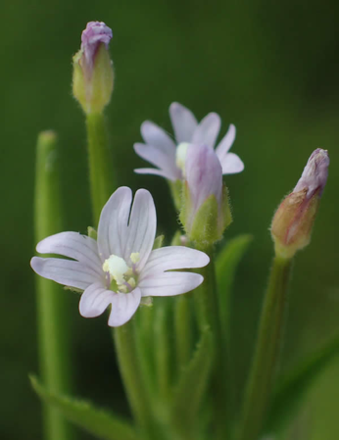
Flowers for classification
Often consistent within a taxonomic group
Numbers of organs
Positions/fusion of organs
Evening-primrose
Oenothera
Onagraceae
Willow-herb
Epilobium
Onagraceae
Beeblossom
Gaura
Onagraceae
Onagraceae: 4 petals, 4 or 8 stamens, inferior ovary

Slide 9
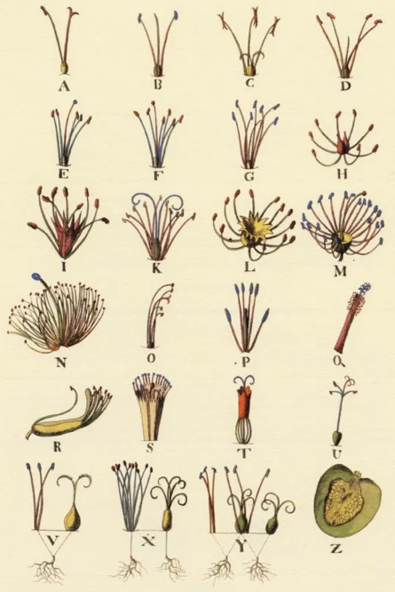
‘Sexual system’ of classification
Monandria (1 stamen)
Diandria (2 stamens)
Triandria (3 stamens)
Tetrandria (4 stamens)
Pentandria (5 stamens)
Hexandria (6 stamens)
Heptandria (7 stamens)
Octandria (8 stamens)
Enneandria (9 stamens)
Decandria (10 stamens)
Dodecandria (12 stamens)
Icosandria (20 stamens)
Polyandria (many stamens)
Didynamia (2 stamens longer than the rest)
Tetradinamia (4 stamens longer than the rest)
Monadelphia (all stamens fused together)
Diadelphia (stamens fused into two sets)
Polyadelphia (stamens fused into many sets)
Syngenesia (filaments separate but anthers fused)
Gynandria (stamens fused to pistil)
Monoecia (unisexual flowers on the same plant)
Dioecia (unisexual flowers on different plants)
Polygamia (unisexual and hermaphroditic combinations)
Cryptogamia (flowers hidden from view)
The original classifications by Linnaeus used flower features to group plants
Reproductive organs: number and fusion of stamens / pistils

Slide 10
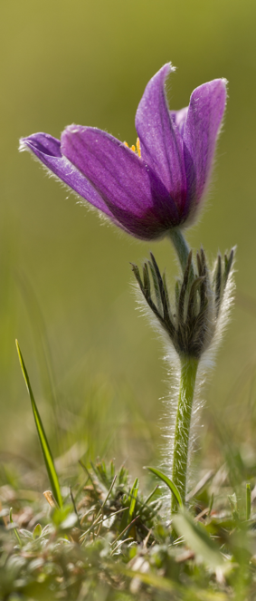
Just to clarify…
This is a flower
This is a plant
(roots included)
“Is it a flower or a weed?”

Slide 11

How flowers grow
Flowers are determinate shoots with condensed internodes

Slide 12
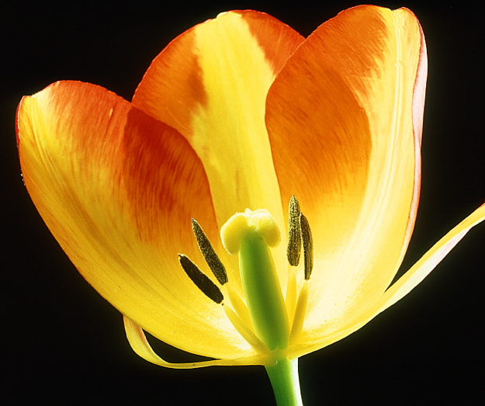
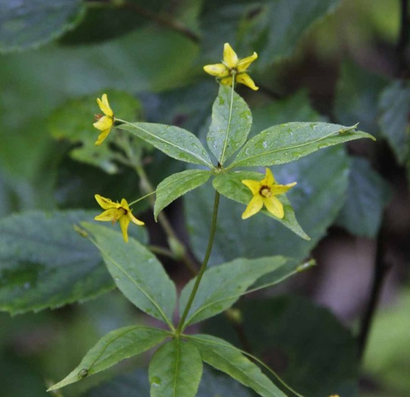
Whorls
Often organs are arranged at the same level
Most common arrangement for floral organs
Tulip
Tulipa gesneriana
Liliaceae
Whorled loosestrife
Lysimachia quadrifolia
Primulaceae
…an example of whorled leaves

Slide 13
A ‘whorl-wind’ tour of the flower
Up to four types of organs, in the same order from outside to inside

Slide 14
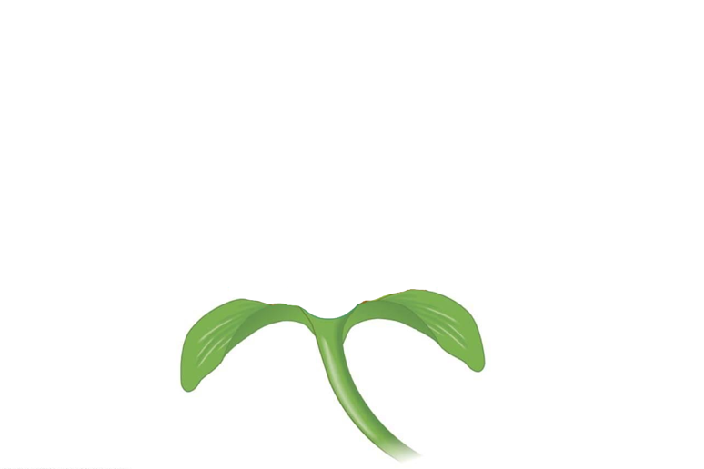
Calyx
…made up of sepals
Sepals

Slide 15
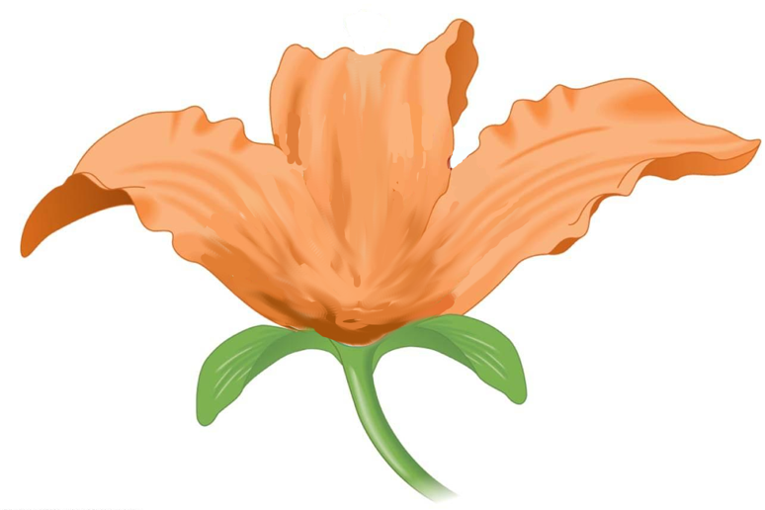
Corolla
…made up of petals
Petals

Slide 16
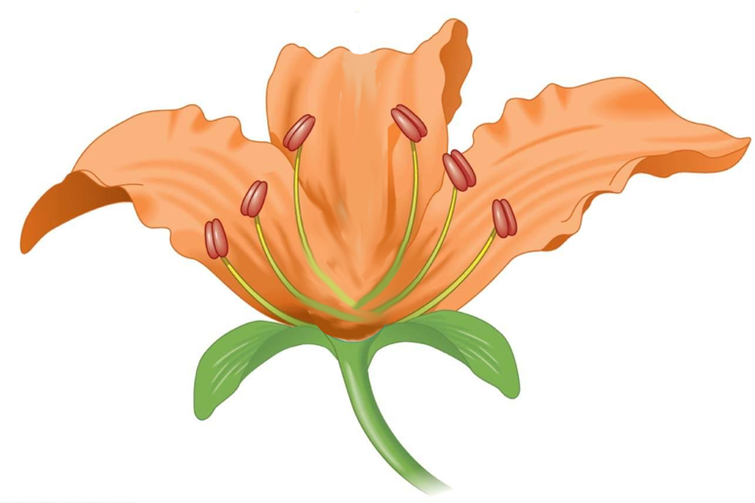
Androecium
…made up of stamens
Pollen (inside)
Stamen
Anther
Filament

Slide 17
Gynoecium
…made up of carpels
Several carpels often fused into pistil
Stigma
Style
Ovary
Pistil =
fused carpels
Ovule
(inside)

Slide 18
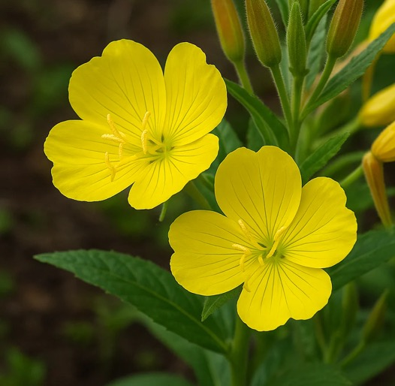

Floral diagrams and formulas
K = calyx
C = corolla
A = androecium
G = gynoecium
Evening-primrose
Oenothera
Onagraceae
K 4 C 4 A 4 G 8

Slide 19
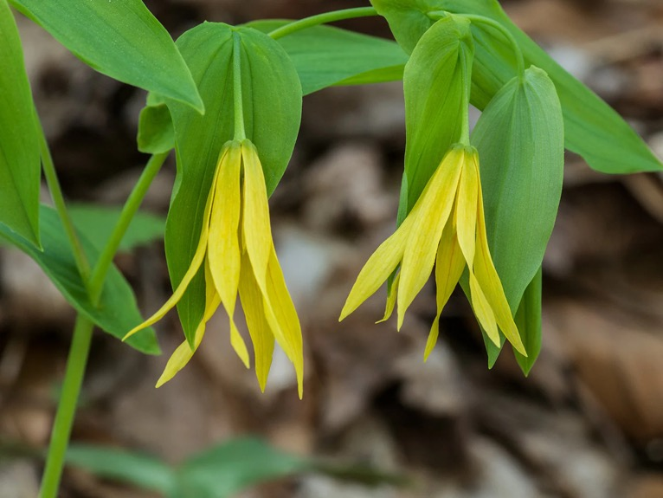
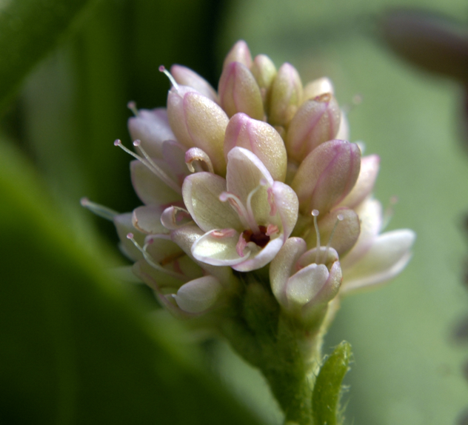
Tepals
If the distinction between petals and sepals is unclear, we call them ‘tepals’
Bellwort
Uvularia
Colchicaceae
Smartweed
Persicaria
Polygonaceae

Slide 20
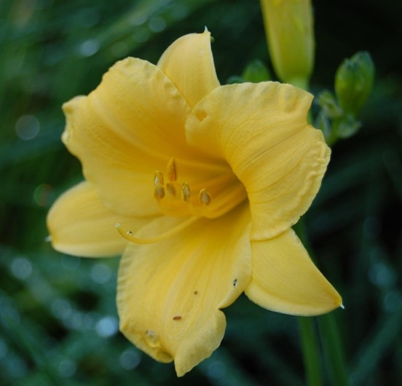
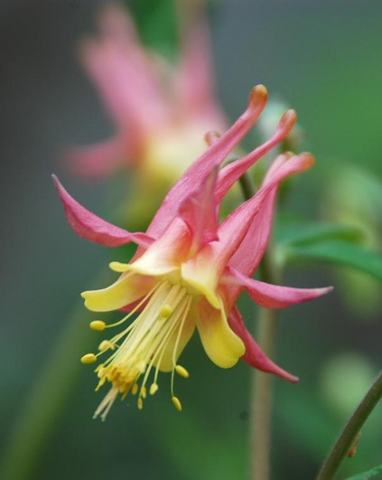
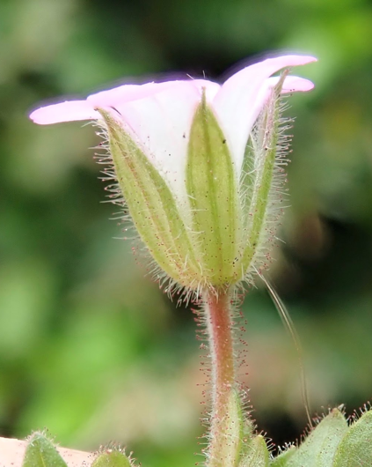
Perianth
Perianth: collective term for petals/sepals/tepals
Columbine
Aquilegia
Ranunculaceae
Chickweed
Cerastium
Caryophyllaceae
Daylily
Hemerocallis
Asphodelaceae

Slide 21
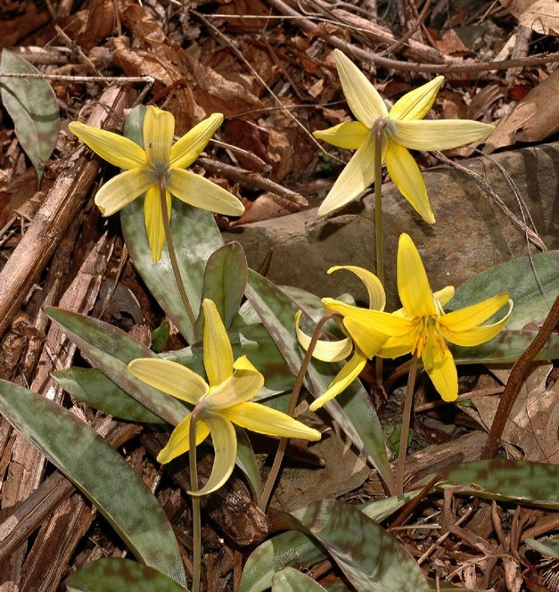

Undifferentiated perianth
P = perianth (tepals)
K = calyx (sepals)
C = corolla (petals)
A = androecium (stamens)
G = gynoecium (carpels)
Erythronium
Liliaceae
P 6 A 6 G 3

Slide 22

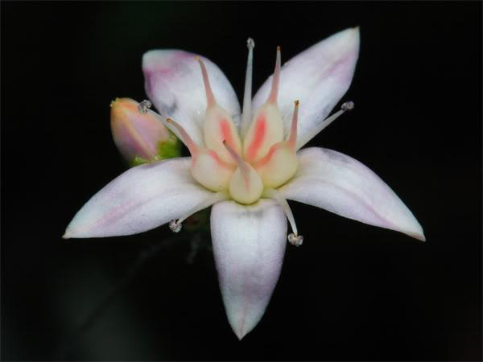
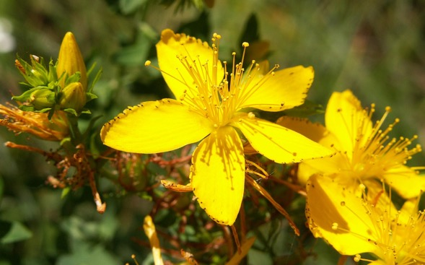
To infinity and beyond!
Perianth and androecium often have common denominator
Ranges given for family; species often constant organ number
Organs numbering more than ~15 are not counted (‘numerous’)
∞ (infinity symbol) used instead
K 5 C 5 A 5 G 5
K 5 C 5 A ∞ G 5
Hypericum
Hypericaceae
Crassula
Crassulaceae

Slide 23
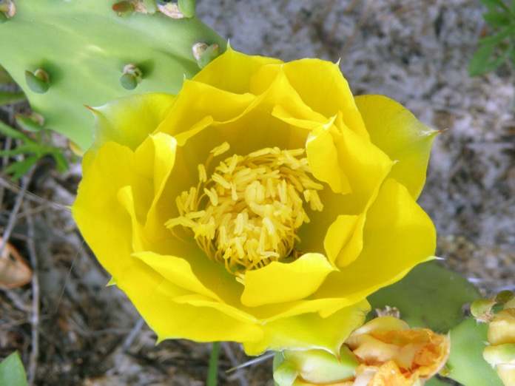
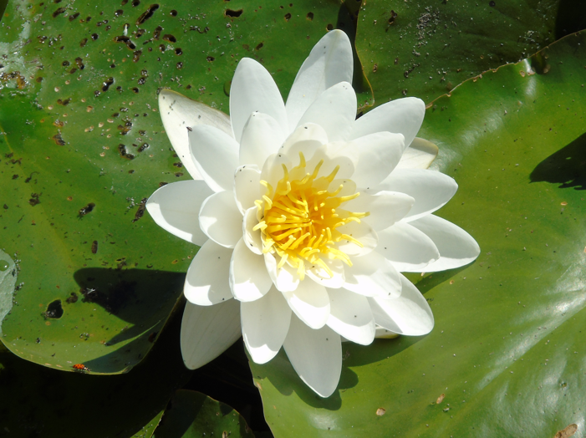
Some flowers are spiral instead of whorled
Spiral arrangement usually coincides with large number of organs
Organs still in the same order as whorled flowers
Opuntia
Cactaceae
Nymphaea
Nymphaeaceae

Slide 24
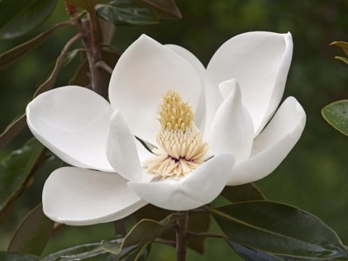

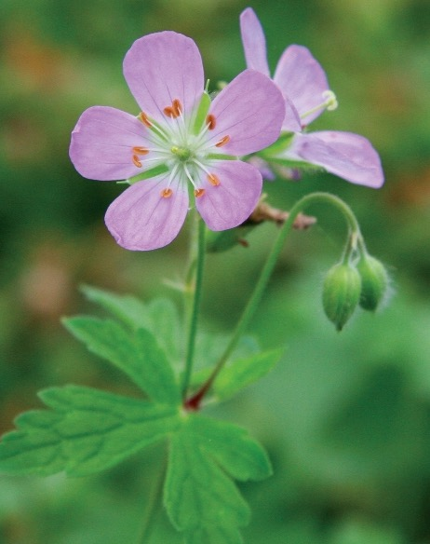
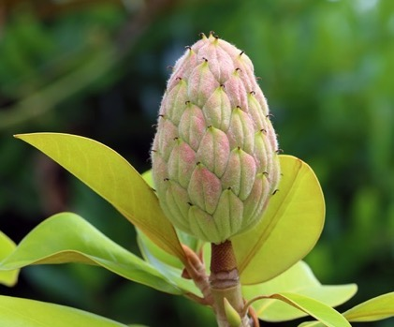
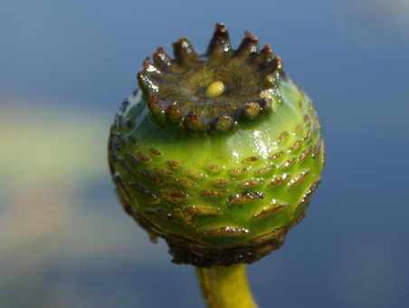
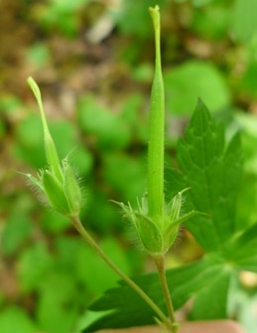
Whorled or spiral?
Magnolia
Water-lily
Nymphaea
Geranium
How many petals and other organs?

Slide 25
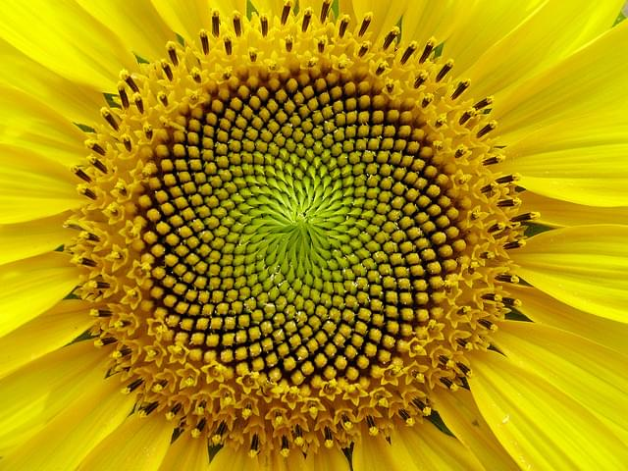
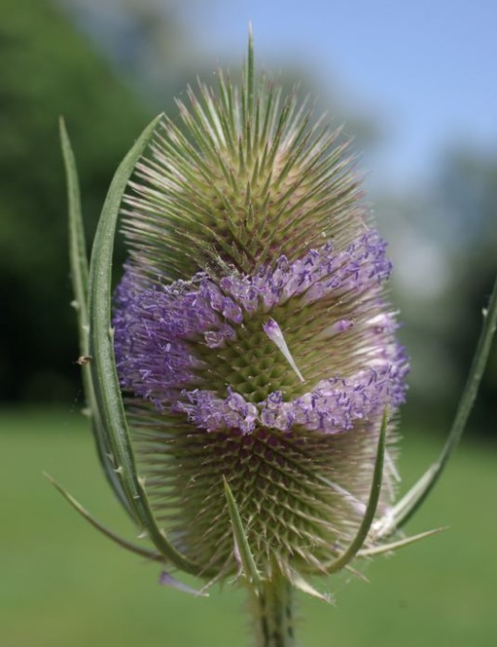
Spirals are a common pattern in plants
Note: These images depict groups of flowers, not individual flowers
Sunflower
Helianthus
Asteraceae
Teasel
Dipsacus
Caprifoliaceae

Slide 26
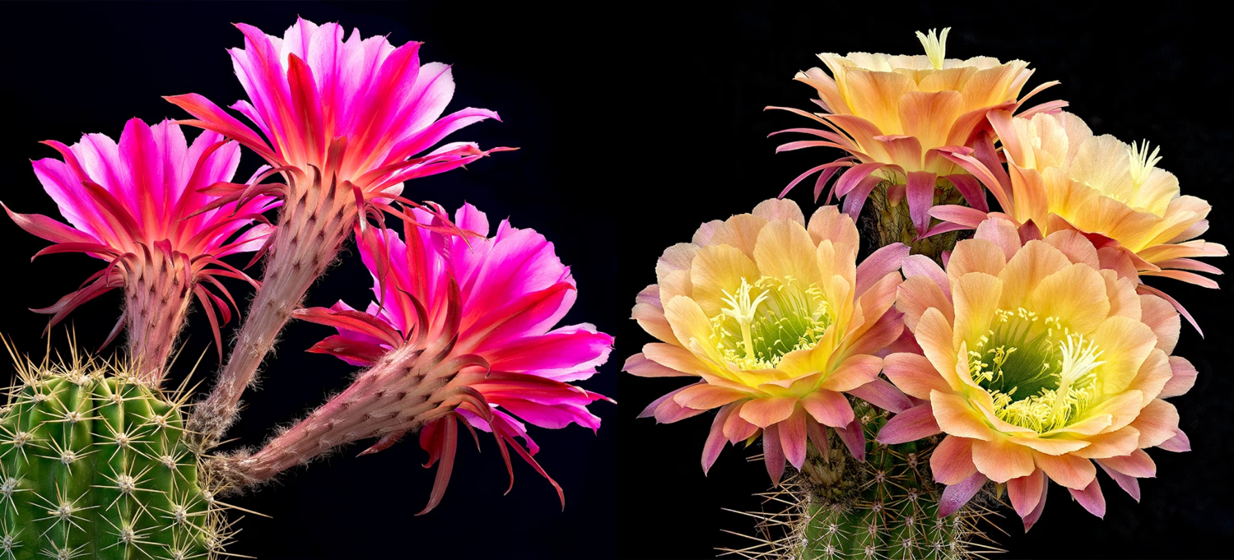
Spirals are less common in flowers
Cactaceae

Slide 27
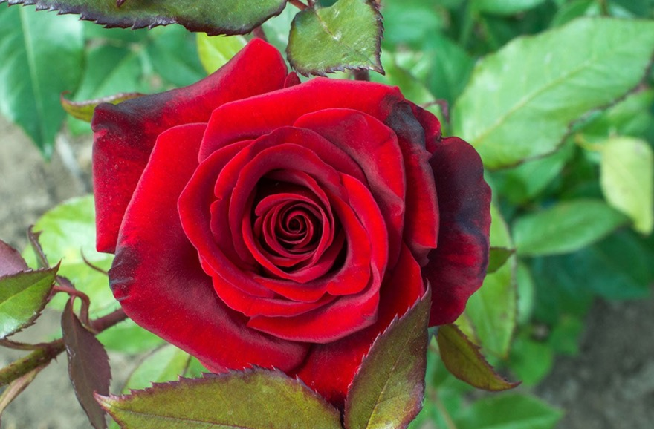
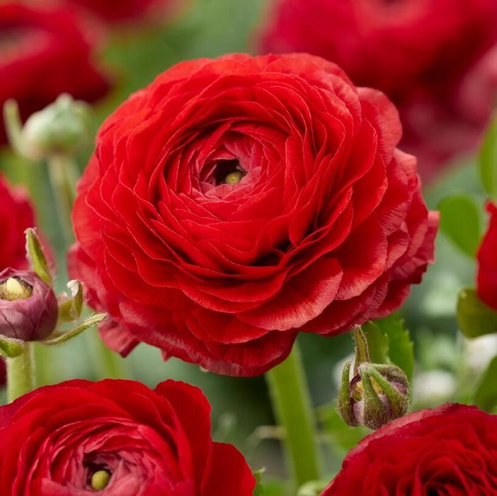
Cultivated spirals
Many cultivated flowers are mutants with unnaturally numerous petals
Ranunculus
Ranunculaceae
Rosa
Rosaceae

Slide 28
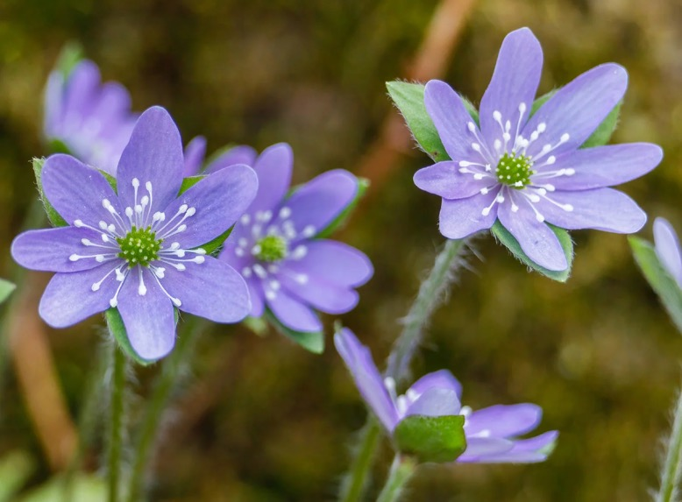
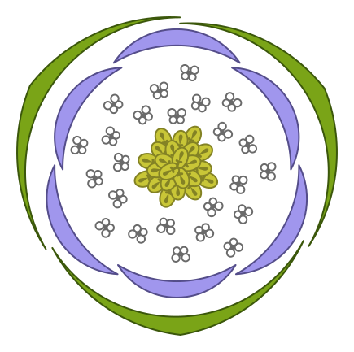
Mixed spiral and whorled arrangements
Organs with > 10 units tend to be spiral
Hepatica
Ranunculaceae
K 3 C 6 A ∞ G ∞

Slide 29
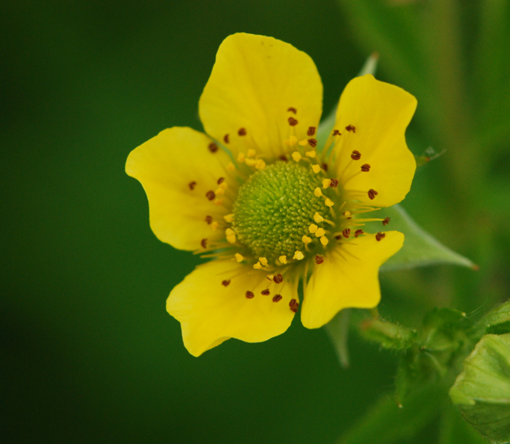
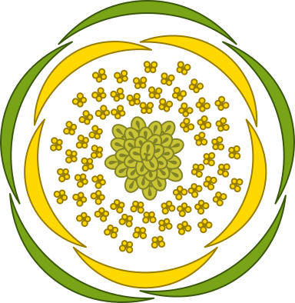
Rosaceae (rose family) with spiral gynoecia
Geum
Rosaceae
K 5 C 5 A ∞ G ∞

Slide 30
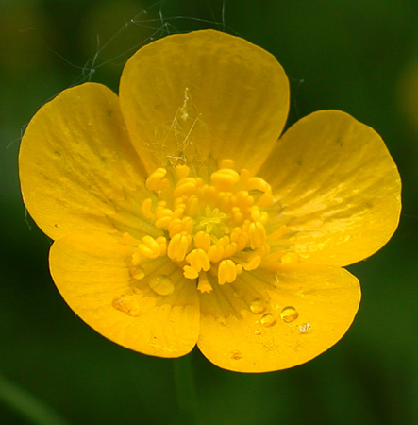
Ranunculaceae (buttercup) with spiral gynoecia
Ranunculus
Ranunculaceae
K 5 C 5 A ∞ G ∞

